Slide 1
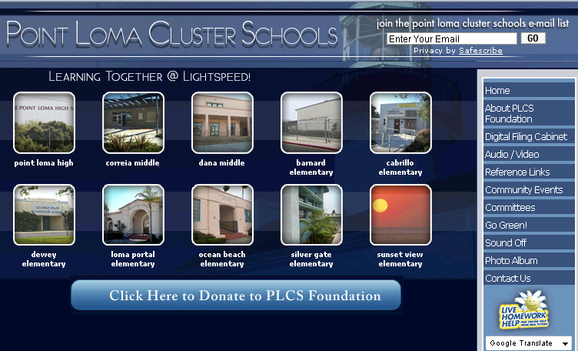

P O I N T L O M A C L U S T E R S C H O O L S
Cluster Governance
Empowerment Framework
. . . . . . . . . . . . . . . . . . . . . . . . . . . . . . . . . . .
A COMMUNITY CONVERSATION
March 2011
Engage Empower Educate

Slide 2

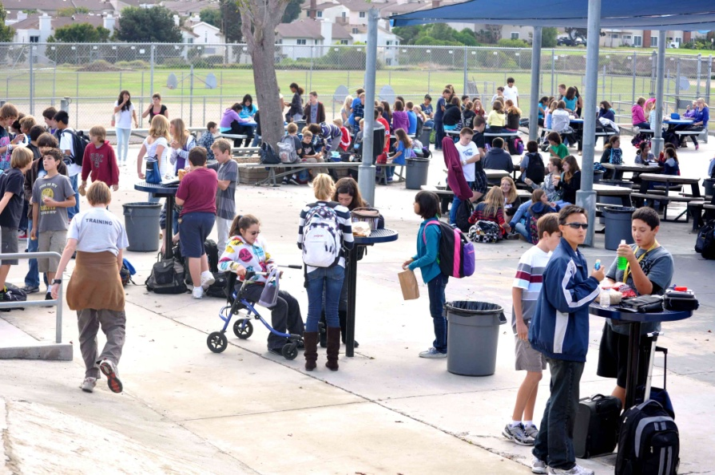
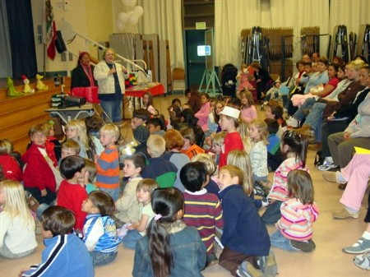

Point Loma Cluster Schools
Cluster Overview
2009 - 2010
Engage • Empower • Educate
Cluster Quick Facts
10 schools
Over 6,200 students / App. 500+/- per grade
15% English Language Learners
45% Qualify For Free / Reduced Lunch
31% GATE students
10% Students with disabilities
Ethnicity:
46% White
38% Hispanic
7% African American
2% Filipino
2% Asian
5% Other
Proficiency - Cluster Students:
67% proficient in English Language Arts
53% proficient in Math

Slide 3

Point Loma Cluster Schools
Cluster Overview
PLCSF Values
Engage • Empower • Educate
About the Point Loma Cluster
The Point Loma Cluster consists of ten public schools located in the Point Loma area of San Diego, California. Part of the San Diego Unified School District, the Cluster has 10 schools which serve over 6,400 students grades K-12.
About the Point Loma Cluster Schools Foundation (PLCS)
In 2006, a group of parents, teachers, and principals from each school engaged in a strategic planning process to develop a unified vision for the Point Loma Cluster. The end result was the creation of a strategic plan to enhance and support our community schools. This led to establishing a 501c3. Board of directors representation from each school is one parent and one staff.
PLCS Vision
The Point Loma Cluster Schools, through innovative practices and collaborative efforts, will be the model of educational excellence; inspiring passionate life-long learners, critical thinkers, unbounded achievers, and responsible global citizens.
PLCS Mission
It is the mission of the Point Loma Cluster to inspire in each student a joy of life-long learning and inquiry about one’s individuality, community, and the world. As stakeholders, our commitment is to sustain and support the best practices in education that empower each child with knowledge, skills and values necessary to become confident, self-sufficient adults and global citizens.
One parent and one staff
from each school serve on
the PLCS Foundation
Board of Directors.
www.pointlomacluster.com
Over 6,000 parents,
teachers and staff are connected via the Point Loma Cluster e-blast system.

Slide 4


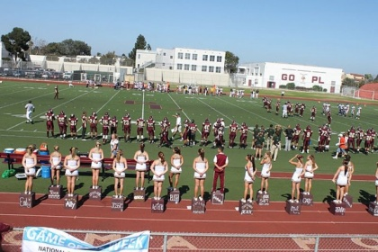
Point Loma Cluster Schools
Cluster Overview
PLCSF Values
Engage • Empower • Educate
VALUES
Point Loma Cluster Schools Foundation
EXCELLENCE
Educational superiority attained through perseverance,
hard work and dedication to learning.
INTEGRITY
Education with a foundation of honesty, courage and respect.
INNOVATION
An educational program which uses creative problem solving, global thinking and exploration and “risk” taking to determine and implement change so that our students can be well prepared to actively participate and be contributing members of society.
COLLABORATION
Respecting and valuing input from all community members (students, parents and staff) and working together to create a superior educational program
BALANCE
Encouraging students to discover and then maintain a balance that includes physical, emotional and mental fitness

Slide 5



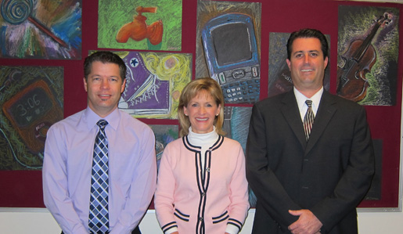



Point Loma Cluster Schools
Cluster Leadership
Engage • Empower • Educate
Cluster Schools (Grades) Principal
Elementary School
Sunset View (K-4) Jackie McCabe
Silver Gate (K-4) Sandy McClure
Ocean Beach ((K-4) Margaret Johnson
Loma Portal (K-4) Glenda Gerde
Cabrillo (K-4) Nestor Suarez
Dewey (K-4) Tanya Belsan
Barnard (K-6) Ed Park
Middle Schools
Dana Middle (5-6) Diane Ryan
Correia Middle (7-8) Patty Ladd
High School
Point Loma HS (9-12) Bobbie Samilson
District Administration / School Board
Area Superintendent : Dianna Carberry
School Board Rep: Scott Barnett
Over 300 dedicated teachers and staff
serve our Cluster students and community!

Slide 6
Point Loma Cluster Schools
Stakeholders
2009-10
Engage • Empower • Educate
Students 6,400
Parents 6,200
Teachers 300
Staff 150
Principals 10
Total 13,060
Cluster Stakeholders

Slide 7
Point Loma Cluster Schools
Cluster Demographics
2009-10
Engage • Empower • Educate
10 schools, over 6,200 students…..diversity is a strength of our Cluster schools

Slide 8
Point Loma Cluster Schools
School Demographics
2009-10
Engage • Empower • Educate
Cluster student population by cluster school…….

Slide 9
Point Loma Cluster Schools
Cluster Schools
Snapshot 2009-10
Barnard
244 students
69% free lunch
28% English Language Learners
17% Students with Disabilities
API Score: 874 (Similar Schools – n/a)
% of Students Proficient:
English 66%
Math 82%
Engage • Empower • Educate
Budget per
Student:
$8,937
Total:
$2.18MM
Title 1 = Title 1 funding schools will lose due to board policy change
Total Cluster Budget $37MM
Average $5,913 Per Student
Click school API score to learn more
Point Loma High School
2,065 students
42% free lunch
10% English Language Learners
10% Students w/ Disabilities
API Score: 758 (Similar Schools = 771)
% of Students Proficient:
English 58%
Math 19%
Budget per
Student:
$5,328
Total:
$11.33MM
Cabrillo
187 students
74% free lunch
34% English Language Learners
5% Students with Disabilities
API Score: 805 (Similar Schools = 808)
% of Students Proficient:
English 54%
Math 61%
Budget per
Student:
$8,290
Total:
$1.55MM
Ocean Beach
345 students
61% free lunch
22% English Language Learners
11% Students with Disabilities
API Score: 924 (Similar Schools = 841)
% of Students Proficient:
English 81%
Math 86%
Budget per
Student:
$6,773
Total:
$2.34MM
Correia Middle School
828 students
45% free lunch
17% English Language Learners
10% Students with Disabilities
API Score: 828 (Similar Schools = 809)
% of Students Proficient:
English 67%
Math 52%
Budget per
Student:
$5,704
Total:
$4.72MM
Dewey
434 students
74% free lunch
24% English Language Learners
7% Students with Disabilities
API Score: 870 (Similar Schools = 805)
% of Students Proficient:
English 67%
Math 68%
Budget per
Student:
$6,581
Total:
$2.86MM
Silver Gate
504 students
17% free lunch
6% English Language Learners
10% Students with Disabilities
API Score: 903 (Similar Schools = 914)
% of Students Proficient:
English 76%
Math 83%
Budget per
Student:
$5,784
Total:
$2.92MM
Dana Middle School
807 students
46% free lunch
13% English Language Learners
11% Students with Disabilities
API Score: 869 (Similar Schools = 859)
% of Students Proficient:
English 75%
Math 70%
Budget per
Student:
$5,605
Total:
$4.52MM
Loma Portal
371 students
34% free lunch
21% English Language Learners
10% Students with Disabilities
API Score: 896 (Similar Schools = 879)
% of Students Proficient:
English 78%
Math 81%
Budget per
Student:
$5,880
Total:
$2.41MM
Sunset View
436 students
15% free lunch
11% English Language Learners
8% Students with Disabilities
API Score: 924 (Similar Schools = 938)
% of Students Proficient:
English 78%
Math 88%
Budget per
Student:
$5,851
Total:
$2.55MM

Slide 10
Point Loma Cluster Schools
Student Proficiency
Snapshot 2009 -10
Engage • Empower • Educate
Cluster Schools – API Scores
Note: Testing for grades 2 -11
 | Annual Performance Index
 | Sorted By Highest API |  |  |  |  | Sorted by Similar Schools in State
 |  |  |  |  |  |  |  | Similar
 |  |  | Similar
 | School | API | Schools | Diff |  | School | API | Schools | Diff
 | Ocean Beach | 924 | 841 | 83 |  | Ocean Beach | 924 | 841 | 83
 | Sunset View | 924 | 938 | -14 |  | Dewey | 870 | 805 | 65
 | Silver Gate | 903 | 914 | -11 |  | Correia | 841 | 809 | 32
 | Loma Portal | 896 | 879 | 17 |  | Loma Portal | 896 | 879 | 17
 | Barnard | 874 | * | * |  | Dana | 869 | 859 | 10
 | Dewey | 870 | 805 | 65 |  | Cabrillo | 805 | 808 | -3
 | Dana | 869 | 859 | 10 |  | Silver Gate | 903 | 914 | -11
 | Correia | 841 | 809 | 32 |  | Point Loma | 758 | 771 | -13
 | Cabrillo | 805 | 808 | -3 |  | Sunset View | 924 | 938 | -14
 | Point Loma | 758 | 771 | -13 |  | Barnard | 874 | * | *
Proficiency Levels By School
 | English Lang. Arts - Sorted by Highest % |  |  |  |  | Math - Sorted by Highest %
 | School | Total | Proficient | % |  | School | Total | Proficient | %
 | Ocean Beach | 164 | 133 | 81% |  | Sunset View | 250 | 219 | 88%
 | Sunset View | 250 | 196 | 78% |  | Ocean Beach | 164 | 141 | 86%
 | Loma Portal | 214 | 166 | 78% |  | Silver Gate | 291 | 241 | 83%
 | Silver Gate | 291 | 221 | 76% |  | Barnard | 125 | 102 | 82%
 | Dana | 774 | 584 | 75% |  | Loma Portal | 214 | 174 | 81%
 | Correia | 799 | 533 | 67% |  | Dewey | 190 | 149 | 78%
 | Dewey | 190 | 128 | 67% |  | Dana | 774 | 538 | 70%
 | Barnard | 125 | 83 | 66% |  | Cabrillo | 104 | 63 | 61%
 | Point Loma | 1,520 | 874 | 58% |  | Correia | 791 | 415 | 52%
 | Cabrillo | 104 | 56 | 54% |  | Point Loma | 1,437 | 274 | 19%
 | Total | 4,431 | 2,974 | 67% |  | Total | 4,340 | 2,316 | 53%
= Similar schools in California
Cluster Schools - Student Proficiency
% of Students Proficient
Cluster Wide Proficiency: 67% for English Language Arts and 53% for Math
There are many factors attributable to proficiency such as socioeconomic status, race/ethnicity, parental involvement , student mobility etc.

Slide 11
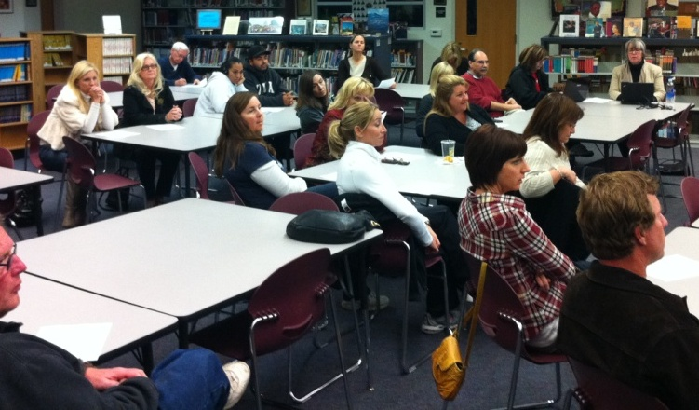

Point Loma Cluster Schools
Empowerment Framework
Discussion
Engage • Empower • Educate
A SEAT AT THE TABLE
Empowering Schools for Cluster-Wide Excellence
While we are an engaged Cluster, we are not an empowered Cluster. We do not have a seat at the decision-making table.
Q. Without that authority, can we effectively address those issues that impact the 6,400 students attending Point Loma Schools?

Slide 12
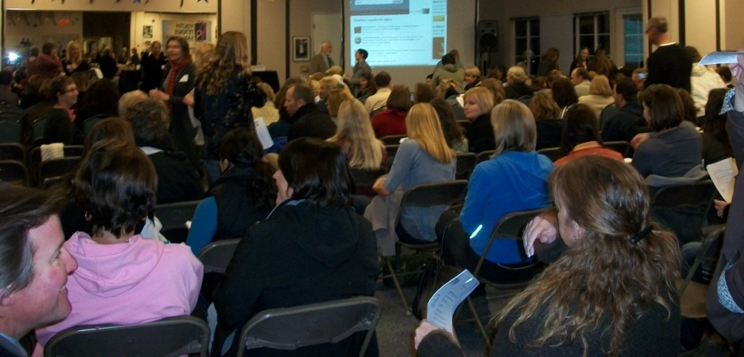
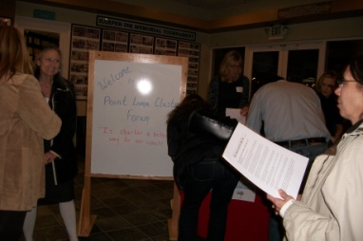
Point Loma Cluster Schools
Empowerment Framework
Discussion
Engage • Empower • Educate
WHY WE ARE HERE
In 2010, a cluster wide dialogue began in the to ask how we can move from and engaged learning community to an empowered one.
SUPPORTING THE DIALGOUE
The first step was a Memorandum of Understanding with the district to explore ways the Point Loma Cluster could increase authority over some of these issues of concern, particularly budgeting.
OPTIONS
As the dialogue unfolded, 2 options were explored for obtaining our increasing our authority and ability to impact the foremost issues of concern:
(1) cluster-wide charter or
(2) a strong cluster governance model.

Slide 13
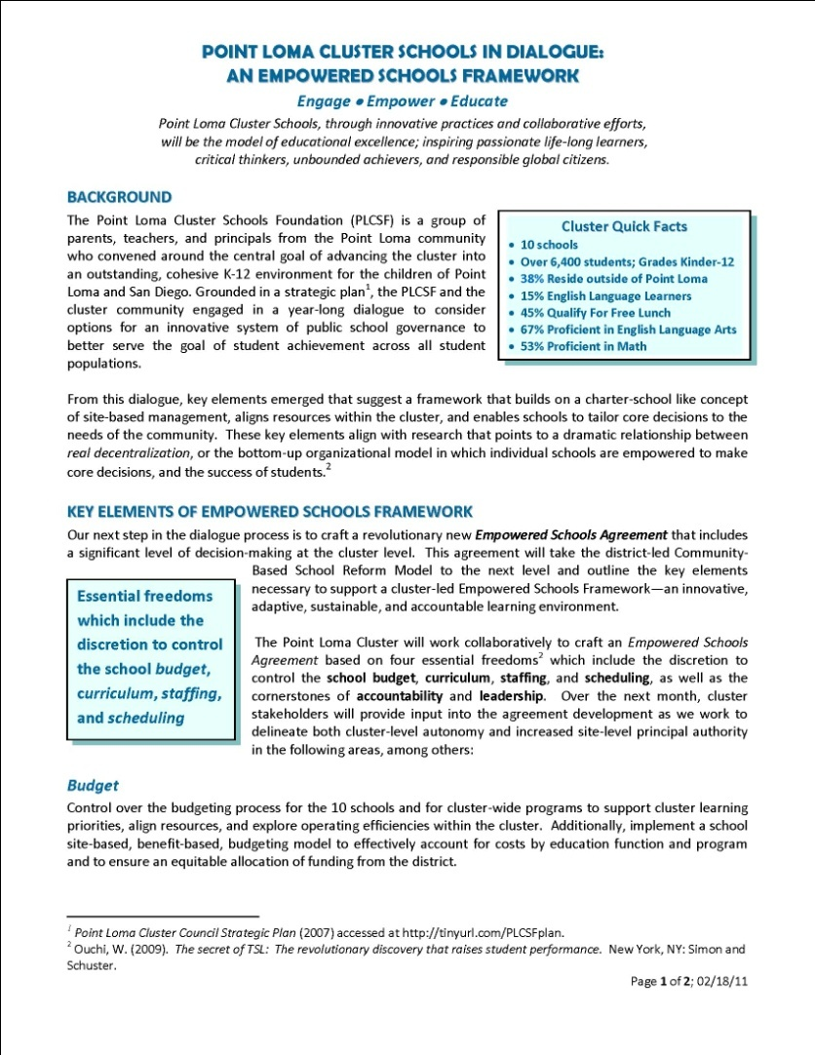
Point Loma Cluster Schools
Empowerment Framework
Discussion
Engage • Empower • Educate
EMPOWERED SCHOOLS FRAMEWORK
In 2011, after over a year of input from Point Loma stakeholders, an Empowered Schools Framework draft was developed as a starting point for framing the first steps towards empowerment and a strong cluster governance model.
  Budget
  Staffing
  Scheduling
  Accountability
  Scheduling
  Leadership
This framework is being developed to increase our ability at the cluster and at the school-site level to make real decisions that will move us towards ours vision of cluster-wide excellence.

Slide 14
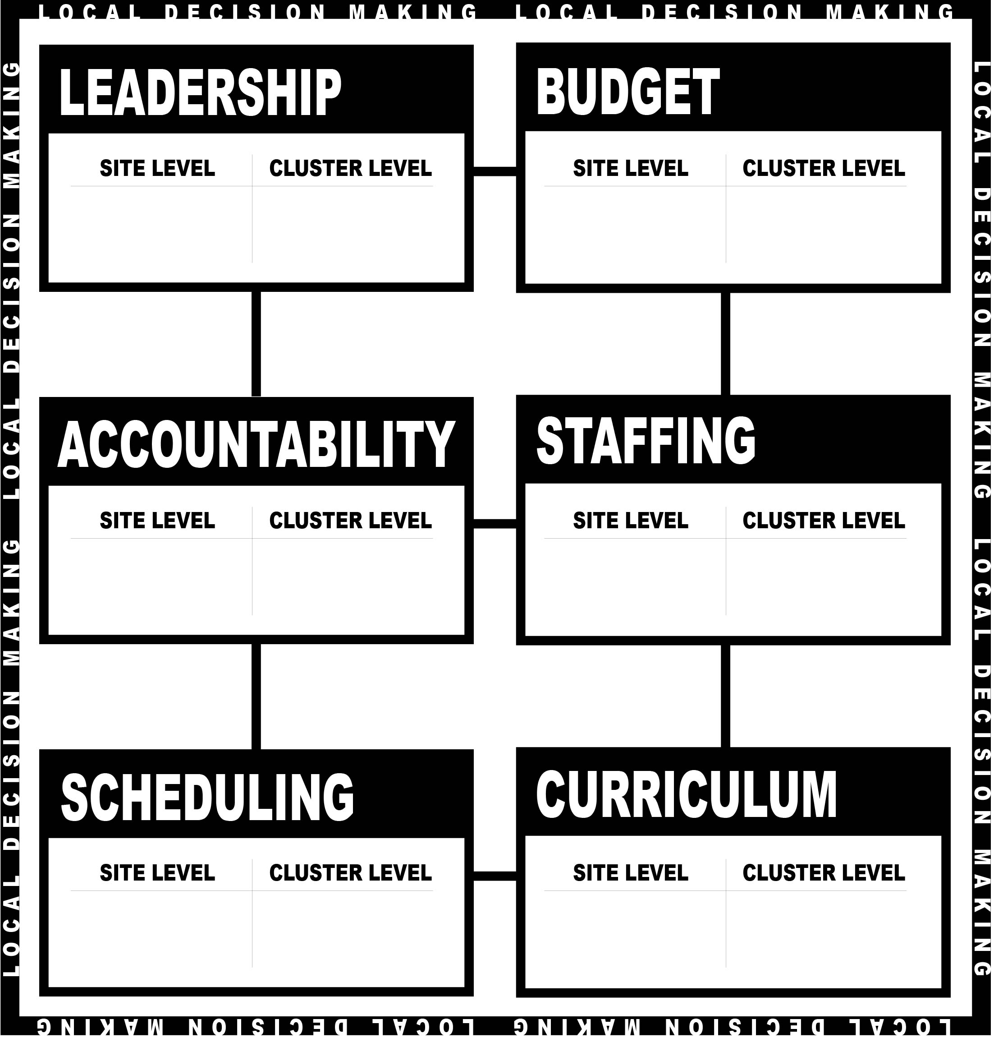
Point Loma Cluster Schools
Empowerment Framework
Discussion
Engage • Empower • Educate
SUPPORTING SCHOOLS
Community input has made
it clear that two levels of decision-making authority
are needed to support the empowerment framework:
At the school site level
At the cluster level
to support our
ten school sites.

Slide 15
Point Loma Cluster Schools
Empowerment Framework
Discussion
Engage • Empower • Educate
BUDGET
What kind of
decision-making authority do you want for your site?
What kind of
decision-making authority do you want for your cluster?
SOME COMMENTS WE HAVE HEARD:
A fair share of the funding from the district to the cluster-level.
Budget authority for programs and facilities that meet a
cluster-wide need (e.g. VAPA, professional development, multi-purpose field)
Funding that follows the student, particularly the additional
funding that goes along with students from socio-
economically disadvantages families (TITLE1)
What kind of decision-making authority do you want for…
SITE LEVEL | CLUSTER LEVEL

Slide 16
Point Loma Cluster Schools
Empowerment Framework
Discussion
Engage • Empower • Educate
STAFFING
What kind of
decision-making authority do you want for your site?
What kind of
decision-making authority do you want for your cluster?
SOME COMMENTS WE HAVE HEARD:
Closing of small schools in the cluster.
Continuity of cohesive teaching teams at the school-site level.
Flexibility for professional development across school levels.
Class size & number of students each teacher instructs per day
Quality teaching teams across all school sites.
What kind of decision-making authority do you want for…
SITE LEVEL | CLUSTER LEVEL

Slide 17
Point Loma Cluster Schools
Empowerment Framework
Discussion
Engage • Empower • Educate
SCHEDULING
What kind of
decision-making authority do you want for your site?
What kind of
decision-making authority do you want for your cluster?
SOME COMMENTS WE HAVE HEARD:
Coordination of bell times.
Coordination of busing schedules.
Authority over daily calendars and class time to ensure
flexibility for professional development and for programs
such as internships and project-based learning.
What kind of decision-making authority do you want for…
SITE LEVEL | CLUSTER LEVEL

Slide 18
Point Loma Cluster Schools
Empowerment Framework
Discussion
Engage • Empower • Educate
CURRICULUM
What kind of
decision-making authority do you want for your site?
What kind of
decision-making authority do you want for your cluster?
SOME COMMENTS WE HAVE HEARD:
Alignment of curriculum across
elementary, middle, and high schools
Address tracking issues across
elementary, middle, and high school performance streams
What kind of decision-making authority do you want for…
SITE LEVEL | CLUSTER LEVEL

Slide 19
Point Loma Cluster Schools
Empowerment Framework
Discussion
Engage • Empower • Educate
ACCOUNTABILITY
What kind of
decision-making authority do you want for your site?
What kind of
decision-making authority do you want for your cluster?
SOME COMMENTS WE HAVE HEARD:
All schools and stakeholders accountable for performance
  Dropout rate: 10% / Graduation rate: 89%
  Four-year university (UC/CSU) eligibility rate: 40%
  Students at grade level : Math: 53% / English 67%
360 degree accountability
– students, parents, principals, teachers and staff
What kind of decision-making authority do you want for…
SITE LEVEL | CLUSTER LEVEL

Slide 20
Point Loma Cluster Schools
Empowerment Framework
Discussion
Engage • Empower • Educate
LEADERSHIP
What kind of
decision-making authority do you want for your site?
What kind of
decision-making authority do you want for your cluster?
SOME COMMENTS WE HAVE HEARD:
Area superintendent selection/retention; turnover reduction.
Principal selection and retention; turnover reduction.
Authority at the school-site level for school-site budgeting, staffing, curriculum, scheduling, accountability.
A cluster-level governance organization with decision making authority to interact with the district.
What kind of decision-making authority do you want for…
SITE LEVEL | CLUSTER LEVEL

Slide 21
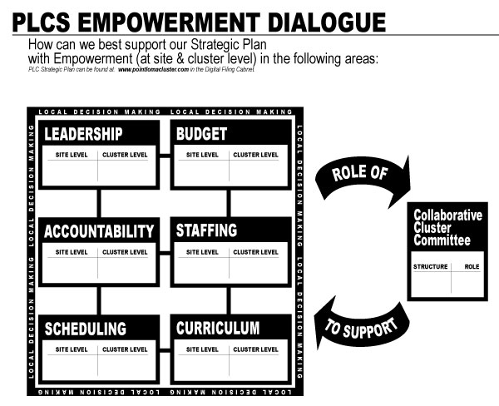
Point Loma Cluster Schools
Cluster Overview
2009 - 2010
Engage • Empower • Educate
SUPPORTING SCHOOLS
Given what you’ve said
about cluster level
decision making…
How might a
Collaborative Cluster Committee (CCC)
be structured
to support
that authority?

Slide 22
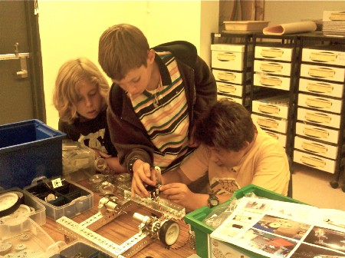



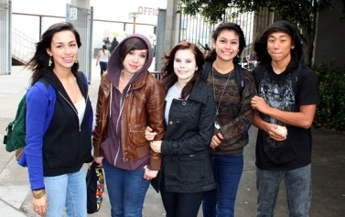

Point Loma Cluster Schools
Empowerment Framework
Discussion
Engage • Empower • Educate
THANK YOU FOR YOUR FEEDBACK
Blog Us
www.plcluster.blogspot.com
Learn More
www.pointlomacluster.com

